Slide 1
“The relationship between DNA methylation, genetic and expression inter-individual variation in untransformed human fibroblasts”

Slide 2

Wagner et al. Genome Biology 2014, 15:R37 http://genomebiology.com/2014/15/2/R37
RESEARCH Open Access
The relationship between DNA methylation, genetic and expression inter-individual variation in
untransformed human fibroblasts
James R Wagner³, Stephan Busche^{1,2}, Bing Ge², Tony Kwan^{1,2}, Tomi Pastinen^{1,2*} and Mathieu Blanchette^{3*}
Notes:
This is a paper published in Genome Biology in 2014 by Wagner et. At.
A Canadian group from McGill University, Montreal
As a super swift summary
The work involves the study of the relationships between the inter-individual variation at the DNA methylation, gene expression and genetic levels
Aim of the paper is understand the relationship between genetics, gene expression and methilation using sample data from a cell culture of fibroblast
where the research question was: what we can infer from the integrated analysis of DNA methylation, gene expression and genetic variation?
SO, let’s start with some previous concepts, like genetic and expression inter-individual variation

Slide 3
Background
What we do understand by variation in each of these levels?
How can we assess the relationship between them?
Notes:
Let’s start with some background concepts

Slide 4
Wagner et al. Genome Biology 2014, 15:R37 http://genomebiology.com/2014/15/2/R37
RESEARCH Open Access
The relationship between DNA methylation, genetic and expression inter-individual variation in
untransformed human fibroblasts
James R Wagner³, Stephan Busche^{1,2}, Bing Ge², Tony Kwan^{1,2}, Tomi Pastinen^{1,2*} and Mathieu Blanchette^{3*}
Subject | SNP1 | SNP2 | SNP3 | SNP4 | SNP5 | SNP6 | SNP7 | SNP8 | SNP9 | SNP10
1 | AA | GG | AA | AC | CC | AC | AG | CC | AC | GG
2 | AC | AA | AA | AC | CC | CC | GG | CC | CC | GG
3 | AA | AA | AA | CC | CC | CC | GG | CC | CC | GG
4 | AA | GG | AG | AC | AC | AC | AG | AC | AC | AG
. | AC | AG | AA | CC | AC | AA | GG | AC | AA | GG
. | AA | GG | AA | CC | CC | AC | GG | CC | AC | GG
n | CC | AG | AA | CC | AC | CC | GG | AC | CC | AG
Notes:
Genetic inter-individual variation occur at the DNA level, in coding and non coding regions and can be characterized by observing the state of different postion along the genome for a set of individuals.
This state can be names as genotype and the position as a locus or loci in plural. Here, we get 10 differente position for n different individuals, where the state or genotype of the position was registered in a matrix arrangement.

Slide 5
Wagner et al. Genome Biology 2014, 15:R37 http://genomebiology.com/2014/15/2/R37
RESEARCH Open Access
The relationship between DNA methylation, genetic and expression inter-individual variation in
untransformed human fibroblasts
James R Wagner³, Stephan Busche^{1,2}, Bing Ge², Tony Kwan^{1,2}, Tomi Pastinen^{1,2*} and Mathieu Blanchette^{3*}
Notes:
To describ The next level, the inter individual gene expression variation

Slide 6
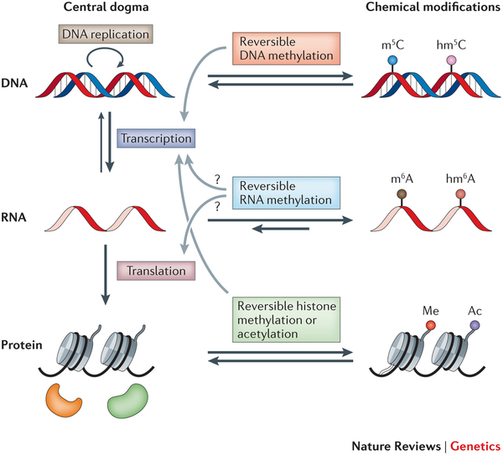
Notes:
We need to remember From molecular biology, that coding regions produce a blue print for proteins synthesis by the proccess of transcription, originating messenger RNA.
When we study the collection of mRNA for a pool of genes we talk of the transcriptome. In addition,
The concentration of the mRNA for a given coding region or gene is going to be dependent of the cell type, the state of developmente, the age of the organism, the pathological state, and the environment

Slide 7
Wagner et al. Genome Biology 2014, 15:R37 http://genomebiology.com/2014/15/2/R37
RESEARCH Open Access
The relationship between DNA methylation, genetic and expression inter-individual variation in
untransformed human fibroblasts
James R Wagner³, Stephan Busche^{1,2}, Bing Ge², Tony Kwan^{1,2}, Tomi Pastinen^{1,2*} and Mathieu Blanchette^{3*}
Subject
1
2
3
.
.
.
n
Gen 1
5.12
1.23
15.90
1.56
27.60
Gen 2
12.0
12.0
12.1
12.1
12.0
Gen k
9.54
0.55
0.45
11.23
2.68
…
…
Gen r
0
0
0
0
0
Notes:
So far, the level of expression of a given gene can be characterized by the concentration of its mRNA. That is measured by some function of their concentration (like the logarithm of the counts).
In such a way that the values of each subject can be also arranged in a matrix like form.
Observe that, for some genes like 1 and k the expression is variable among subjects, maybe due to different pathological states or ages, while gene 2 has a contant expression, and gen r, hasn’t expression at all

Slide 8
Wagner et al. Genome Biology 2014, 15:R37 http://genomebiology.com/2014/15/2/R37
RESEARCH Open Access
The relationship between DNA methylation, genetic and expression inter-individual variation in
untransformed human fibroblasts
James R Wagner³, Stephan Busche^{1,2}, Bing Ge², Tony Kwan^{1,2}, Tomi Pastinen^{1,2*} and Mathieu Blanchette^{3*}
Notes:
But, perhaps the less familiar concept is the DNA methylation

Slide 9
Notes:
This refers to a chemical reaction propitiated by some enzymes that modify the DNA, with the effect of diminishing the expression of a particular gene
This reaction has the particularity of occur over the cytosine adyascent to a guanine
5) Methylation is a chemical reaction that adds a methyl group (a carbon atom surrounded by four hydrogen) on a cytosine base (in prokaryotes, adenine can be methylated)
This reaction is catalyzed by a family of enzymes called methyltransferases.

Slide 10
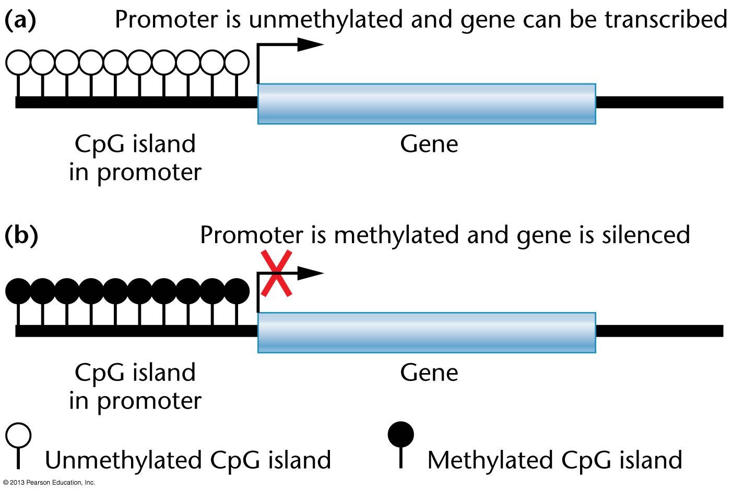
“Shore” 2kb from CpG island
“Shelf” 2-4kb from CpG island
“Open sea” isolated CpG from
the genome
>200bp in length
GC % > 50%
High CpG %
© Pearson Education, Inc.
Notes:
In the next slide, we get a CpG island on a promoter and, as long as we move away from it, we got, respectively, what they call the shore, among 2kilo bases away from the island
The shore, at 2 to 4 kilo bases and the open sea
When the CpG island is methylated, the gene is silenced, by avoiding the binding of the transcription machinery to the DNA strand or by avoiding recruiting some proteins involving in histone stability, making the chromatin more dense which has the effect of impede the access of the transcription machinery to the promoter

Slide 11
Wagner et al. Genome Biology 2014, 15:R37 http://genomebiology.com/2014/15/2/R37
RESEARCH Open Access
The relationship between DNA methylation, genetic and expression inter-individual variation in
untransformed human fibroblasts
James R Wagner³, Stephan Busche^{1,2}, Bing Ge², Tony Kwan^{1,2}, Tomi Pastinen^{1,2*} and Mathieu Blanchette^{3*}
Subject
1
2
3
.
.
.
n
CpG site 1
0.1
0.1
1
0.5
0.5
CpG site 2
0.1
0.9
1
0.7
0.5
CpG site l
0.4
0.4
1
0
0
…
…
CpG site s
0.1
0.1
1
0.5
0.5
Notes:
Acordingly, we can study the methylation at different CpG sites using a ration that goes from 0 (thar represent no methylation) to 1 (total methylation)

Slide 12
Gen k
9.54
0.55
0.45
.
.
11.23
2.68
Subject | SNP1 | SNP2 | SNP3 | SNP4 | SNP5 | SNP6 | SNP7 | SNP8 | SNP9 | SNP10
1 | AA | GG | AA | AC | CC | AC | AG | CC | AC | GG
2 | AC | AA | AA | AC | CC | CC | GG | CC | CC | GG
3 | AA | AA | AA | CC | CC | CC | GG | CC | CC | GG
4 | AA | GG | AG | AC | AC | AC | AG | AC | AC | AG
5 | AC | AG | AA | CC | AC | AA | GG | AC | AA | GG
6 | AA | GG | AA | CC | CC | AC | GG | CC | AC | GG
7 | CC | AG | AA | CC | AC | CC | GG | AC | CC | AG
The significant SNPs are (putative) eQTL
Notes:
So far, so good?
Once the variability was assessed for each layer, the inter relationship can be studied by correlation between the data for different features across the individual
One way is using a GWAS approach, using the expression for a given gen k as response, and SNPs as independent variables, thererore, we can get, one marker at time, the significant association between genomic position and gene expression.
Using the transformed pvalues of each association probe and plotting them against marker position we obtain manhatan plots. Here

Slide 13
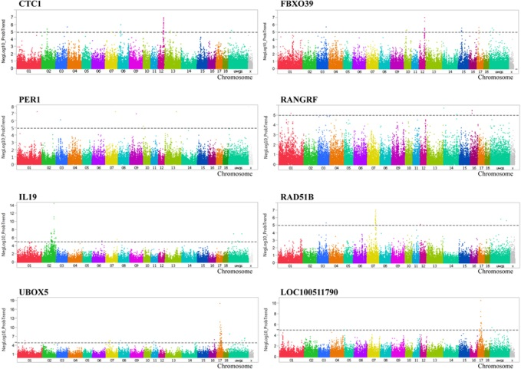
Ponsuksili et al. 2015, Scientific Reports
Notes:
Here, for example, we have manhatan plots for different genes form a work of Ponsulsili et al. Highlighe are two genes in the chromosome 12,
In the first one we got a marker significant and in the same chromosome, so we call it a CIS eQTL
On the other hand, if the sig marker is in other chromosome or distal to the gene, we say that the marker is a putative trasnn eQTL
eQTL can be in CIS or TRANS, depending if they are located nearby the gene over which they have effect, or not, respectively
Like in convencional GWAS, we can plot the –log of the p.values from each hypotesis versus the snp POSITIONS. We do this one gene at time.
Here, in an example extracted from Ponsuksili et al, the manhattan plot for several genes is displayed. Here we see, for two genes on chromoosm 12, a CIS eQTL and a trans eQTL

Slide 14
CpG site l
0.4
0.4
1
.
.
.
0
SNP1 | SNP2 | SNP3 | SNP4 | SNP5 | SNP6 | SNP7 | SNP8 | SNP9 | SNP10
AA | GG | AA | AC | CC | AC | AG | CC | AC | GG
AC | AA | AA | AC | CC | CC | GG | CC | CC | GG
AA | AA | AA | CC | CC | CC | GG | CC | CC | GG
AA | GG | AG | AC | AC | AC | AG | AC | AC | AG
AC | AG | AA | CC | AC | AA | GG | AC | AA | GG
AA | GG | AA | CC | CC | AC | GG | CC | AC | GG
CC | AG | AA | CC | AC | CC | GG | AC | CC | AG
The significant SNPs are (putative) mQTL
Notes:
Accordingly, the same can be done for the methylation intensity, here, we regress the methylation intensity of CpG site l on each marker. To get putatite mQTL

Slide 15
Gen 1
5.12
1.23
15.90
1.56
27.60
Gen 2
12.0
12.0
12.1
12.1
12.0
Gen k
9.54
0.55
0.45
11.23
2.68
…
…
Gen r
0
0
0
0
0
CpG site 1
0.1
0.1
1
0.5
0.5
CpG site 2
0.1
0.9
1
0.7
0.5
CpG site l
0.4
0.4
1
0
0
…
…
CpG site s
0.1
0.1
1
0.5
0.5
Notes:
The same can be done between gene expression and methylation, using one variable as response (the methylation, for example) and the other as explanatory.
Finally, those Markes that are coinicetn

Slide 16
Previous reports
mQTL have been detected in several populations and tissues (Gibbs et al. 2010; Bell et al. 2011).
Frequently, they locate closer to the CpG site.
Methylation-expression correlations are more likely to be negative (Zhang et al. 2010).
Notes:
…And finally, what the authors say about the main results of this papers is that a

Slide 17
Material and Methods
Notes:
Quickly, let’s move to the methodology and materias

Slide 18
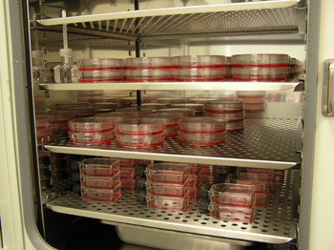
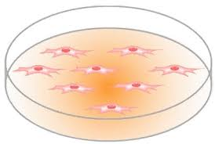
Wagner et al. Genome Biology 2014, 15:R37 http://genomebiology.com/2014/15/2/R37
RESEARCH Open Access
The relationship between DNA methylation, genetic and expression inter-individual variation in
untransformed human fibroblasts
James R Wagner³, Stephan Busche^{1,2}, Bing Ge², Tony Kwan^{1,2}, Tomi Pastinen^{1,2*} and Mathieu Blanchette^{3*}
Notes:
The last (probably) obscure term the the untransformed human fibroblast. These only refer as the way in which subjects data was collected and maintained.
Fibroblast are cells from the connectivity tissue that produce collagen among others thing
Are easy to isolate and maintain in vitro for many generations.
They represent a convenient way to maintain biological data of an individual for a while, to extract samples to study the different layers

Slide 19
900,000 SNP
Autosomes
Intergenic regions
22,916 probes 16,952 genes
Illumina HumanRef8 microarray
Samples of fibroblast from 62 individual, same site
485,000 CpG sites type 1 &2 probes
Illumina 450K microarray
Notes:
Very fast description of the data for the three layers involed the use of nini hundred thousans of SNP in autosoma regions
Among 22 thousa of probes corresponde to approximately sixteen thousand of genes to measure the gene expression and
Almot 22 thousanss of probes to measuremethylation, all these values after edition criteria and normalization.

Slide 20
Results
Methylome
Methylome
mGWAS
Corr(Meth,GE)
Genome
meGWAS
eGWAS
Transcriptome
Notes:
I’m gonna present the resulta for the methylation layer first, then for the mQTL analyys, followed for the eQTL, the common variablitiy of methy and ge, and finally, the overlap between m and e QTL, the me, the SNP s that had both conditions
For the methylation

Slide 21
Distribution of Methylation Values (CpG islands and TSS’s)
Type 1: Probes concentrated around genes
Type 2: Probes more dispersed around the genome
“methylation intensity”
Hypomethylation is more likely to occur
in CpG islands
in gene promoters
Notes:
The first thing they addressed was how the methylation is distributed along the genome. Looking at probes that are mainly located around genes or distributed more uniformelyaround the genom.
Here a bimodal pattern is evident,, with most of the CpG island hypomethylated
And the hypermethylated siteer more likely corresponded to the rest of the genome

Slide 22
Distribution of Methylation Values by Genomic Domain
Active regulatory sites
Figure 2 Mean and variance of beta values of CpG probes associate with several genome marks. Proportion of type II CpG probes falling in various types of genomics regions identified by ENCODE, partitioned by (A) CpG probe mean beta value and (B) percentile of beta value standard deviation (Std. dev.). All data types, except for 28-way conservation, are derived from broad peaks in BJ human foreskin fibroblast cells.
Conserved zones
“methylation intensity”
Most of the CpG sites in regions of active transcription regulatory sites
Conserved domains with almost constant methylation
Active intragenic transcription
CpG sites in active intragenic transcription hypermethylated (?)
Notes:
Here we have the variation of the proportion of CpG probes -lying over specific domains- and the intensity of methylation (CLIC!)
The colours represent the different domains
Less methylated CpG sites were corresponded with chromatin stability zones
Following by CTCF, a transcriptional repressor and conserved domains
With a pike of methylation for active intergenic transcriptors (but most of the hypermethylated sites dind’t overlap the genes and domains considered in this study.
DNAasa hypersensitivity regions
Histone stability
Transcriptional represors
The next plot has the methylation dispersion measured as the percentiles of the methylation standard deviation.
The pattern is almost the same than before, showing that methylation more constitutive, tend to be less dispersed, at lower values for all domains, with the exception that both sites, of perhaps most relevant role in chromatin structure, are more diverse. The gray line shows the increase of standard deviation for each percentile.

Slide 23
Distribution of Methylation Values by Expression Level
v
“methylation intensity”
v
v
CpG sites close to the gene TSS are hypo-methylated
Hypomethylation corresponded with increasing levels of expression
v
Notes:
Consistently, we observe that the CpG probes nearby TSS of active expression genes are more likely to be hypomethylated,
Here we see each probe as a green dot with the corresponding distance to a TSS in the x’s and average methylation as the y’s, the color lines correspond to the mean methylation among probes for different level of gene expression, (separated in four quartiles, with the pink line representing the lowest expression and the black the largest).
Here we se how as closer a probe is to the TSS, lower the methylation, higher the expression

Slide 24
Results
Methylome
Methylome
mGWAS
Corr(Meth,GE)
Genome
meGWAS
eGWAS
Transcriptome

Slide 25
mQTL analysis
v
v
v
Most of the mQTL were closer than 5kb to a CpG site (CIS mQTL)
v
v
Only 6% of the mQTL are far away from the CpG sites
However, data suggest that they aren’t False Positives
Notes:
Here we do have the distribution of significant CpG/SNPs pairs by varying distances. When more thatn one SNP resulted significant for a probe, either the closest SNP (grey) or the most significant (black), in the intervals displayed in x axis, were retained.
Here we see that most of the mQTL were closer Than a

Slide 26
Results
Methylome
mGWAS
Corr(Meth,GE)
Genome
meGWAS
eGWAS
Transcriptome
Notes:
Now, for the eGWAS

Slide 27
v
eQTL analysis
v
v
v
v
eQTL concentrate around gene boundaries
Results occurring more often than expected by chance
v
Notes:
We got that the distribution of most significant overlap with closest,
Bellow the x we get the reference for gene star and termination and we see that most of theeQTL are concentrated in the boundaries

Slide 28
Results
Methylome
mGWAS
Corr(Meth,GE)
Genome
meGWAS
eGWAS
Transcriptome
Notes:
Respecting to the correlation between Methylation and GE,

Slide 29
Distribution of significant correlated CpG probes with GE
Notes:
As expected, Most of the significant negative correlation between Ge and Meth corresponde with active regulatory sites, while intergenic region is mostly non – correlated
Intringilngy, the intergenic regions are positive correlated

Slide 30
Chromatin stability and active transcription
“genome organization” genes
Methylation related probes
“body plan” genes
+ Corr (> 0.452)
- Corr (> 0.452)
Notes:
Looking at a specif cluster of genes, we observe cluster of CpG sites with correlation with the expression, and also matching active transcription sites and domains related with chromatin organization. Most of the eQTL were located in genes of the development.
The arrows represent the direction of the gene transcription,
Here we have positions in the genome consistent with genes of the HOX domains with dense amount of CpG probes with correlation between GE and Methylation.
Let’s see what happens with a gene cluster involved in onthgenesis, the process of morphological developmentof the organism.
In the middle we have the methylation related probes, the lines represent correlation between expression and methylation (blue accounting for positive correlations and golden for negatives ones). From up to bottom, we have chromatin stability domanins, genome organization domains, that regulate the chromatin changes its structure along the genome, and onthological genes.
Many of the probes with negative correlation layd in chromantin stability zones
Most of the probes are localy related with the expression

Slide 31
Results
Methylome
mGWAS
Corr(Meth,GE)
Genome
meGWAS
eGWAS
Transcriptome
Notes:
Looking at the overlap between e and m QTL

Slide 32
+ Corr (> 0.452)
- Corr (> 0.452)
eQTL
mQTL
Notes:
Finaly, we observe some kind of validation fo the previous results, some eQTL in cian, regulate gene expression in this zone, are associated with methylation here, with a negative correlation here
It’s quite an interesting pattern
Now, let’s see what happens when we integrate all the layers together to see the emQTL at the gen level
As before, golden and blue lines account for correlations between methylation and expression)
In addition, we have those grey and cyan lines to indicate mQTL and e QTL.
Here, we have positions associated with the expression of the gene in promoter regions and with methilation in both, the body and the beginning of the gene, overlapping with chromatin stability zones. Also, we have negative correlation of methylation and GE, also overlaped with chromatin stability zones
One example is this gene (C21orf56: codifies for a mithocondrial protein,
Pax8 is involved in ontology
GSTM: Enzimes with broad specificity)
Efecto cascada validacion de emQTL

Slide 33
Discussion
Methylation occurs in a bimodal fashion
Most of the hypo-methylated regions are located nearby active transcription sites
Few loci were associated with both Methylation and Expression variation (sample size?)
However, emQTL in some developmental genes exhibit the same properties than in other tissues (rare but reproducible phenomenon)
The data suggest that most of the regulation occur in CIS, with a non-negligible regulation on TRANS
Notes:
In summary, we observed
They do not discussi it, but methylation and imprinting are very dependent of development. I red that during embryogenesis, a massive desmethylation occurse, and then, during the formation of gametes, It re apear

Slide 34
References
Bell JT, Pai AA, Pickrell JK, Gaffney DJ, Pique-Regi R, Degner JF, Gilad Y, Pritchard JK: DNA methylation patterns associate with genetic and gene expression variation in HapMap cell lines. Genome Biol 2011, 12:R10.
Gibbs JR, van der Brug MP, Hernandez DG, Traynor BJ, Nalls MA, Lai S-L, Arepalli S, Dillman A, Rafferty IP, Troncoso J, Johnson R, Zielke HR, Ferrucci L, Longo DL, Cookson MR, Singleton AB: Abundant quantitative trait loci exist for DNA methylation and gene expression in human brain. PloS Genet 2010, 6:e1000952.
Zhang DD, Cheng LJ, Badner JA, Chen C, Chen Q, Luo W, Craig DW, Redman M, Gershon ES, Liu CY: Genetic control of individual differences in gene-specific methylation in human brain. Am J Hum Genet 2010, 86:411–419.

